Slide 1
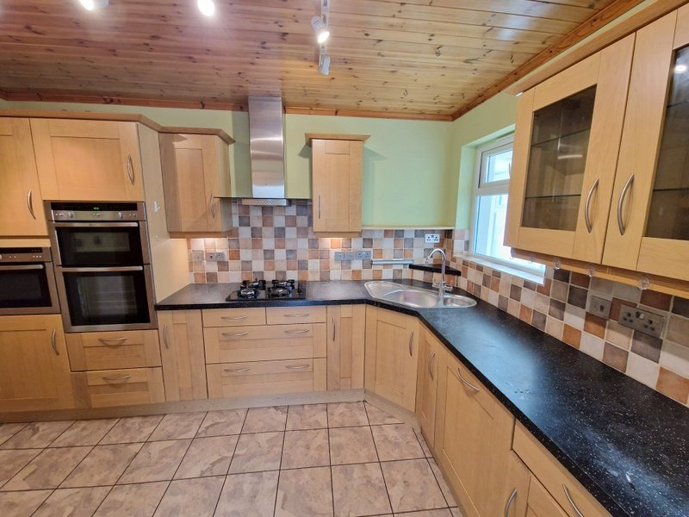
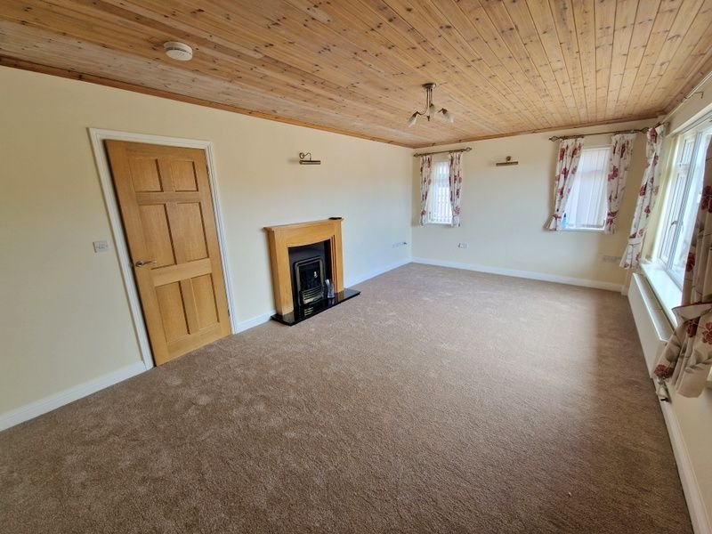
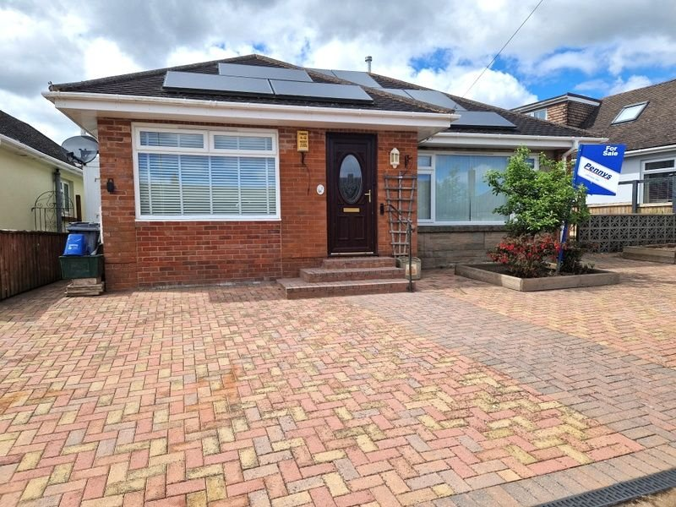
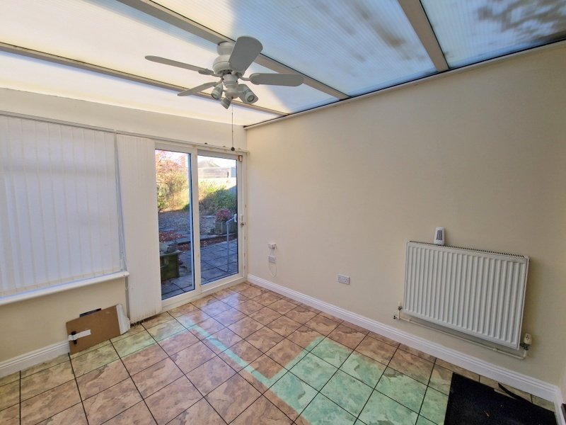
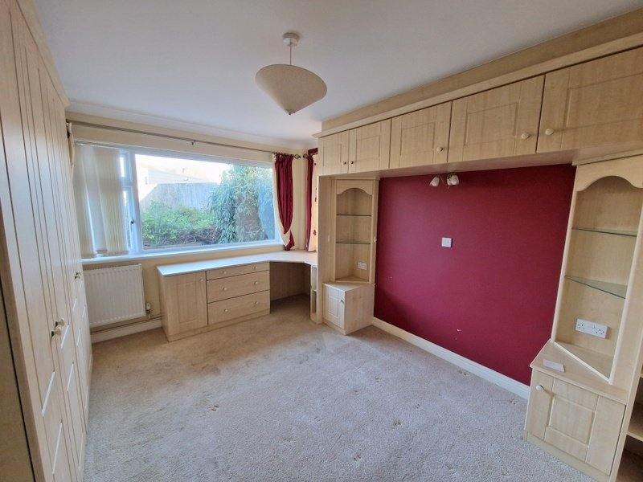
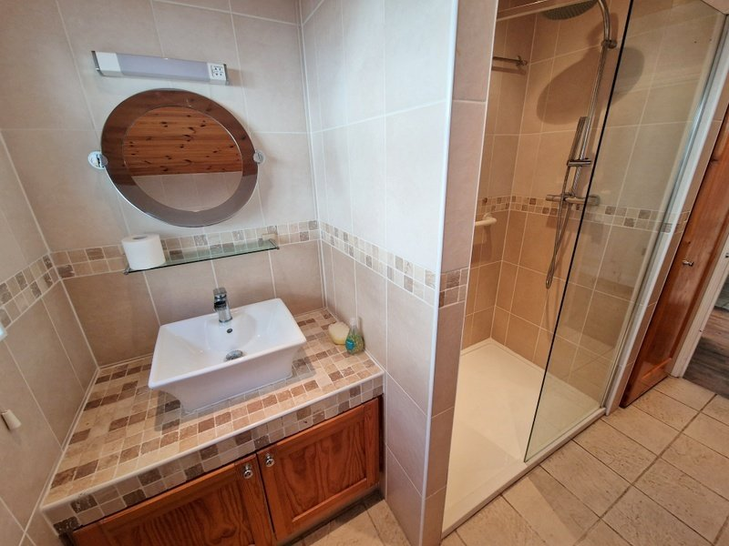
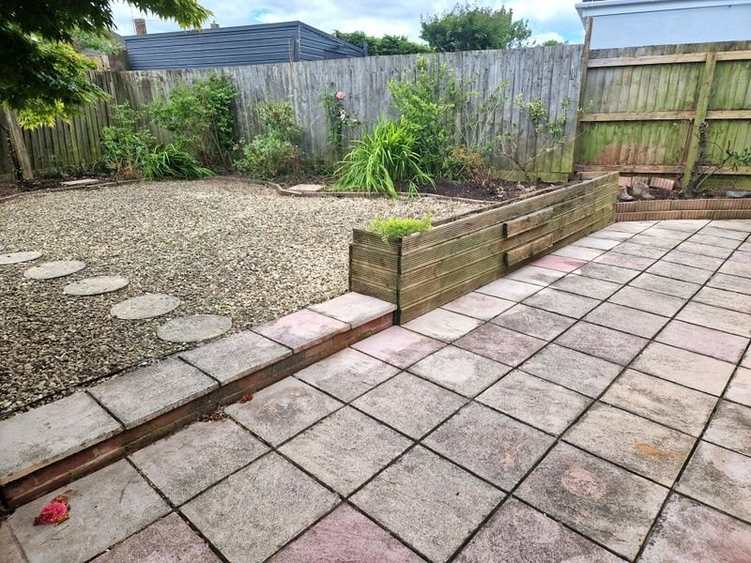
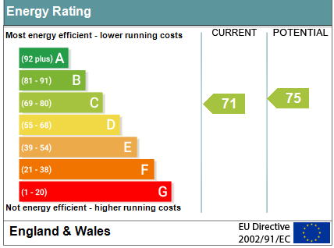
www.pennys.net
3 Warneford Gardens, Exmouth, EX8 4EN
GUIDE PRICE £395,000
TENURE Freehold
A Spacious Detached Bungalow Located In Sought After Location With Manageable Gardens And Off Road Parking
Fully Modernised & Refurbished Over The Past 14 Years •
Spacious Lounge/Dining Room • Well Equipped Modern Kitchen •
Conservatory Extension • Study/Utility Room •
Two Double Bedrooms • Stylish Shower Room/WC •
Gas Central Heating &Double Glazed Windows • Owned PV Panells •
No Onward Chain •
Pennys Estate Agents Limited for themselves and for the vendor of this property whose agents they are give notice that:- (1) These particulars do not constitute any part of an offer or a contract. (2) All statements contained in these particulars are made without responsibility on the part of Pennys Estate Agents Limited. (3) None of the statements contained in these particulars are to be relied upon as a statement or representation of fact. (4) Any intending purchaser must satisfy himself/herself by inspection or otherwise as to the correctness of each of the statements contained in these particulars. (5) The vendor does not make or give and neither do Pennys Estate Agents Limited nor any person in their employment has any authority to make or give any representation or warranty whatever in relation to this property.
PENNYS ESTATE AGENTS
2 Rolle House, Rolle Street, Exmouth, Devon, EX8 2SN
Tel: 01395 264111 EMail: help@pennys.net

Slide 2
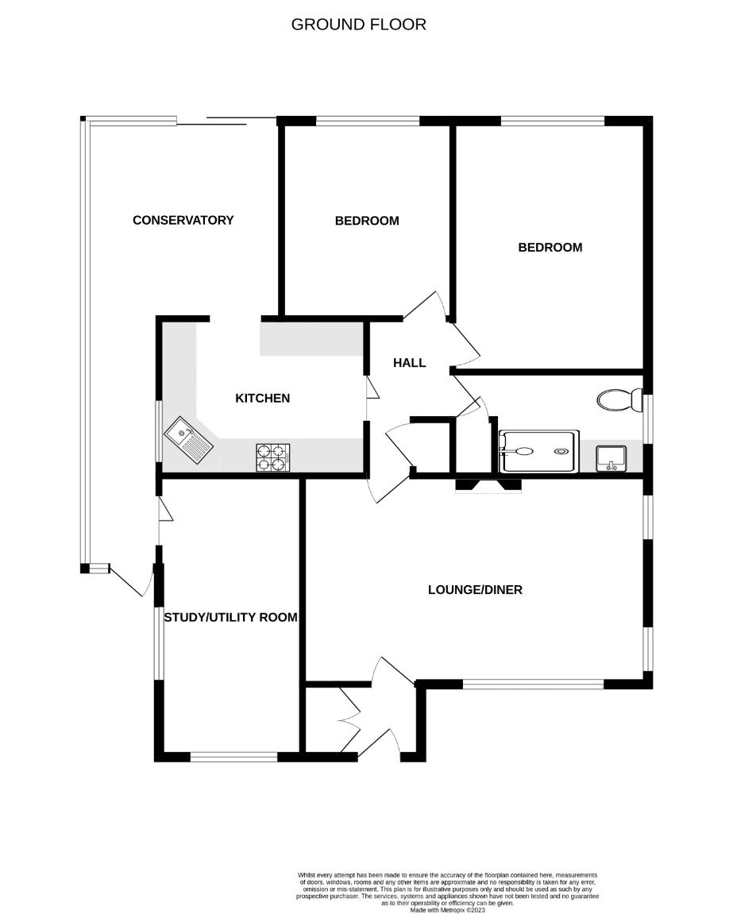
3 Warneford Gardens, Exmouth, EX8 4EN
THE ACCOMMODATION COMPRISES: uPVC front door with oval shaped window and inset; outside light. ENTRANCE PORCH: Wood effect flooring; built-in cupboards which also houses solar panel inverter; inner door to: LOUNGE: 6.1m x 3.63m (20'0" x 11'11") A spacious and bright room with double glazed windows to front and side aspects; television point; telephone point; radiator; attractive fire surround housing living flame coal gas fire; door to: INNER HALLWAY: Wood effect flooring; linen cupboard also housing Valliant gas boiler serving domestic hot water and gas central heating; access via loft ladder to roof space; radiator; telephone point, KITCHEN: 3.61m x 2.69m (11'10" x 8'10") A modern well planned kitchen with pattern work top surfaces with a range of cupboards, drawer units and integrated dishwasher beneath; one and a quarter bowl sink unit with mixer tap; four ring gas hob with stainless steel chimney style extractor hood over; built-in oven and grill with cupboards above and drawer units below; wall mounted cupboards with concealed lighting under; tiled surrounds; tiled floor; radiator; space for large fridge freezer; pull out larder style cupboards to each side and cupboards over; double glazed window to side aspect. CONSERVATORY: 3.48m x 3.3m (11'5" x 10'10")A fine addition to the accommodation extended to provide SIDE WALKWAY 4.39m x 1.02m (14'5" x 3'4") With double glazed door to front aspect and door to STUDY/UTILITY ROOM; wall lighting; radiator. The conservatory enjoys double glazed windows over looking the garden and sliding patio doors giving access to the garden; radiator; power sockets; fan light. BEDROOM ONE: 4.42m x 3.3m (14'6" x 10'10") uPVC double glazed window to rear aspect; radiator; range of built-in bedroom furniture to include two bedside tables with display units over, range of built-in wardrobes, drawer units and high level storage cupboards over bed area; wall light; television point. BEDROOM TWO: 3.45m x 3.05m (11'4" x 10'0") uPVC double glazed window to rear aspect; radiator; television point. SHOWER ROOM/WC: 3.35m x 1.83m (11'0" x 6'0") Stylish suite with ease of access double shower cubicle with fixed rainfall hose and detachable shower head hose; splash screen; wash hand basin set on a tiled display shelf with cupboards under and mirror over; recess ceiling spotlights; fitted cupboard; WC with push button flush; chrome heated towel rail; light shaver socket; fully tiled walls; tiled floor; double glazed window with pattern glass; extractor fan light. STUDY/UTILITY ROOM: A versatile room formally the garage with radiator; plumbing for an automatic washing machine; double glazed windows to side and front aspect; fitted cupboards.
OUTSIDE: To the front of the property there is a block paved garden and driveway providing ample parking, raised flower beds, gate gives access to side garden with outside tap and vegetable garden. To the rear is an attractive garden planned with ease of maintenance in mind comprising of a patio area ideal for outside entertaining, raised fishpond and decorative stone garden, shed, greenhouse and a variety of shrub beds offering an array of colour.
FLOOR PLAN:

